Slide 1


Pet Adoption Trend Analysis
Furrever Home
BY : Team Powerpuff Girls

Slide 2
Contents
Problem Statement & Motivation
Project Overview
Project Flow
Data Description
AWS Services- S3, Glue
Data Analysis - Redshift and Python
Data Visualization - Tableau and Website
ML - Prediction model
Key Learning and Future Scope

Slide 3
Problem Statement & Motivation
01
03
02
04
There are currently over 5k independently run animal shelters across the world providing love and care to millions of abandoned animals. While many of these animals are adopted into loving homes, the adoption rates are still worse than we expect As per research paper Pet Statistics | Shelter Intake and Surrender | ASPCA 6.5 million animals enter animal shelters each year. Furthermore, each year 1.5 million shelter animals are euthanized.
Save Life
Reduces Stress
Adoption means you save a life
Pets are emotional stress busters
Training is easier
Affordable
Training adopted dogs is proven to be easier
Buying a pet is not cheap

Slide 4
Project Overview
01
04
02
05
03
06
Our project helps animal shelter ensure that more animals are adopted by highlighting the key features which make the per adoptable
Time- Based Adoption
Breed Analysis
Our analysis will help identify trend patterns from years 2013-2022
This will help identify if a particular breed of an animal type has more likelihood of being adopted
Animal Type and Gender
Animal Condition
The analysis focuses on cats, dogs, birds and other livestock
This will help in determining the probability of a healthy vs sick animal being adopted
Animal Age
Color of animal
Age analysis will help identify if older pets are being abandoned for younger pets
This will show analysis of most adopted breed and the most preferred color

Slide 5








Project Flow
Data Source
S3- Data Storage
ETL
Python, Glue, Excel
Analysis
Redshift ,Python
Visualization
Tableau , Matplotlib

Slide 6

Data Description
Data is collected from Austin’s open data portal from 2013 to current
Austin Animal Center Intake and Outcomes. Intakes data represent the animals that get in, in the center. Outcomes are the animals that leave the center.
All animals are given unique animal ids during intakes and outcome
Date of intake, where the animal was found, condition, age, animal type are some of the import characteristics recorded on intake of any animal
Date of outcome, outcome type, age on outcome, animal type are some of the import characteristics recorded on outcome of any animal
https://data.austintexas.gov/Health-and-Community-Services/Austin-Animal-Center-Outcomes/9t4d-g238
https://data.austintexas.gov/Health-and-Community-Services/Austin-Animal-Center-Intakes/wter-evkm

Slide 7
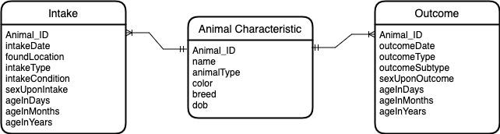
Data Model

Slide 8

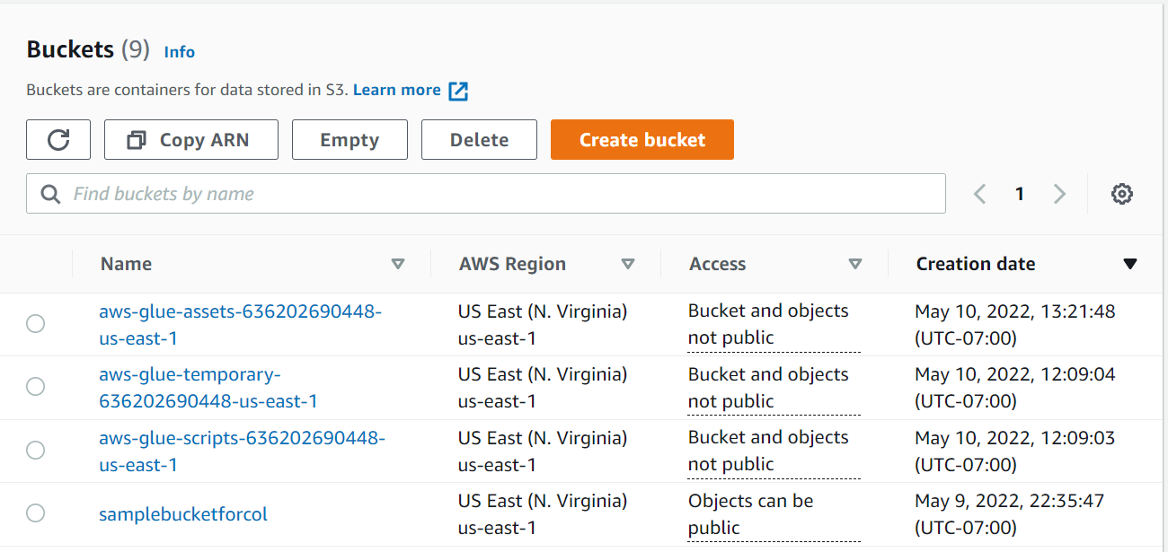
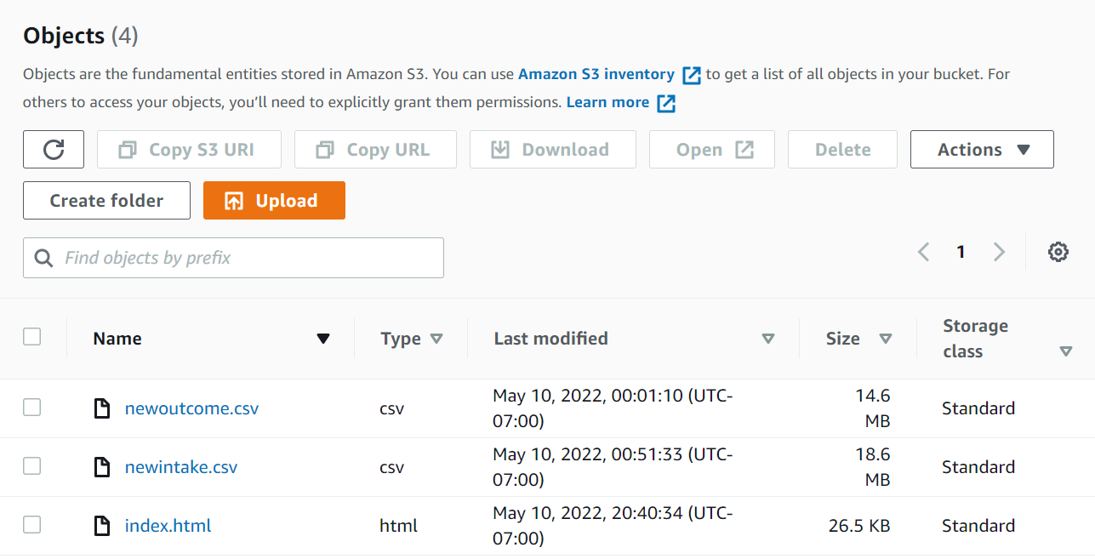
All About AWS
S3
Created source S3 bucket and uploaded CSV Files

Slide 9

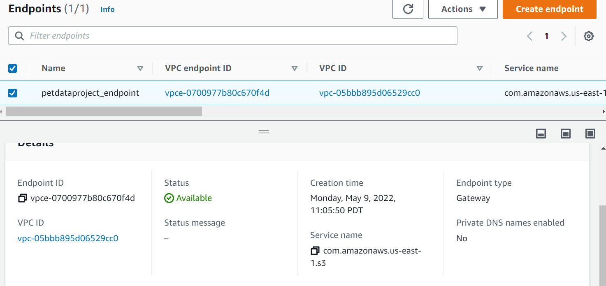
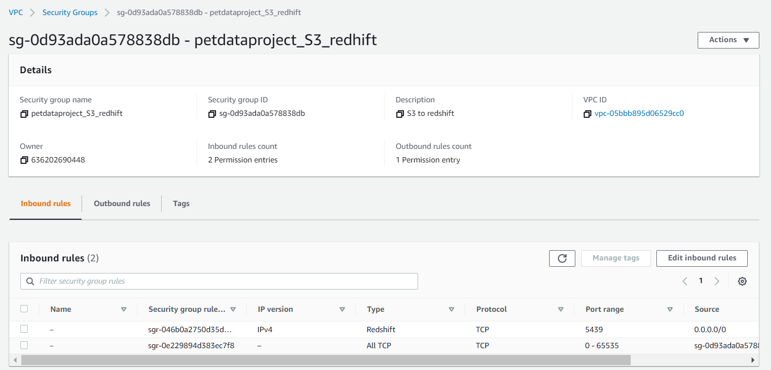
VPC Endpoint
Security Groups
VPC
Created 2 VPC endpoints to access data source(S3) and to connect to redshift

Slide 10
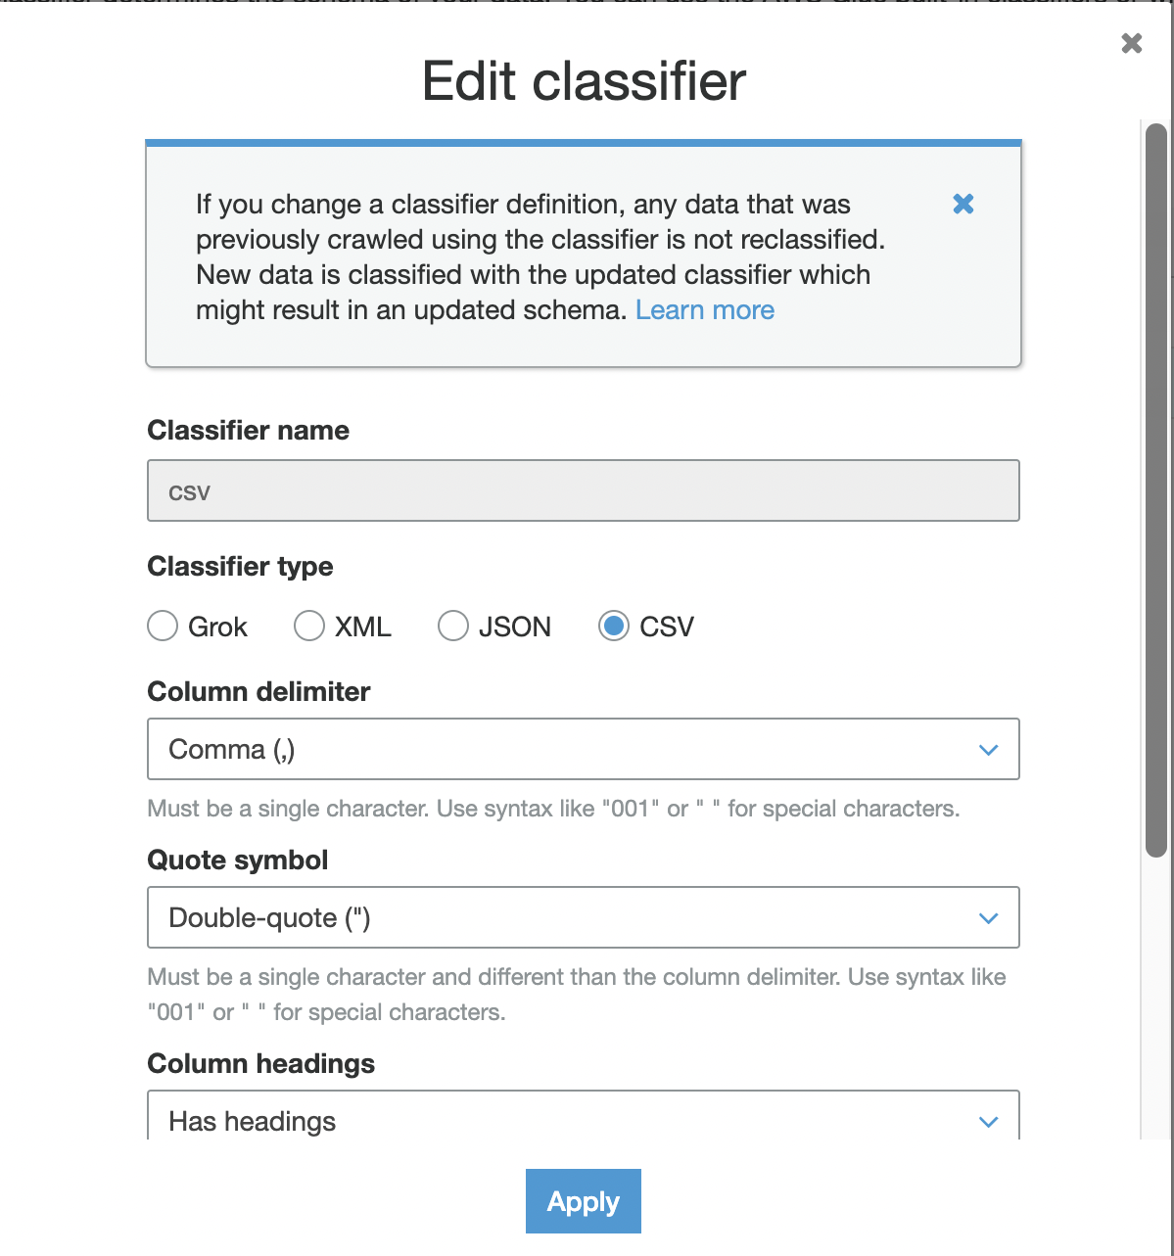
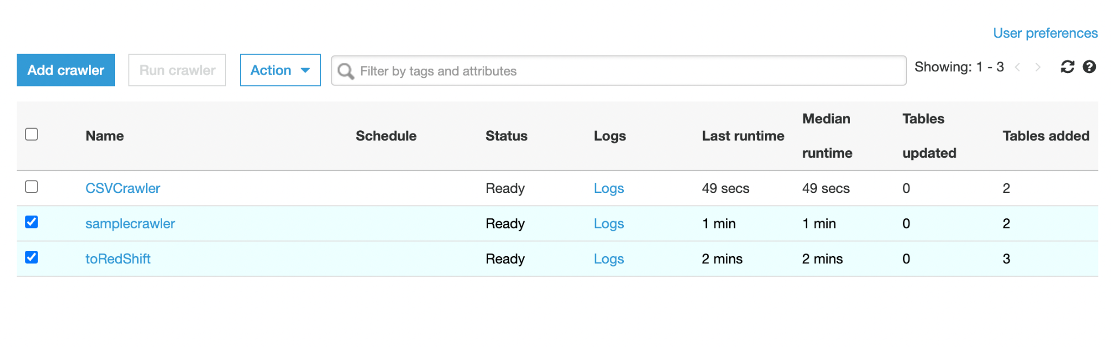
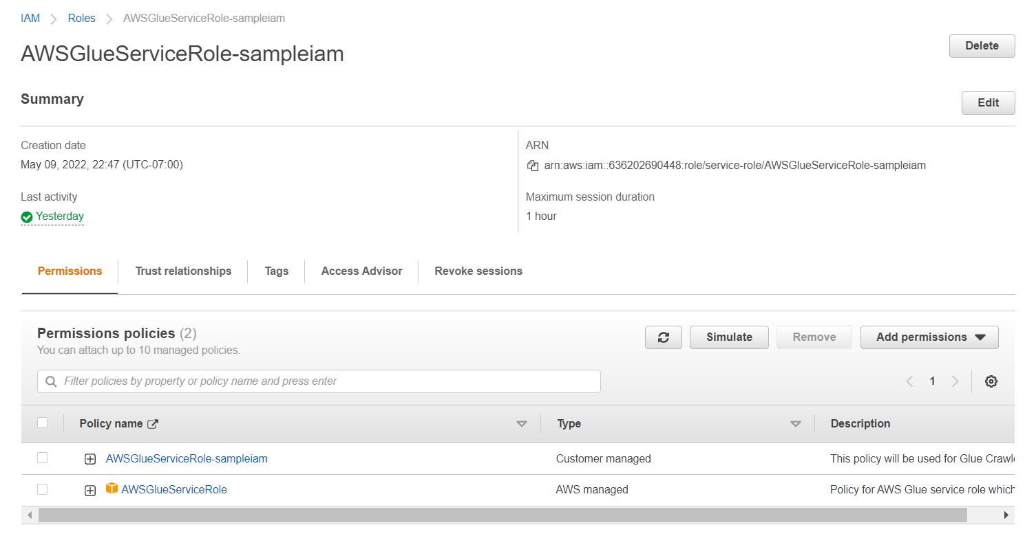
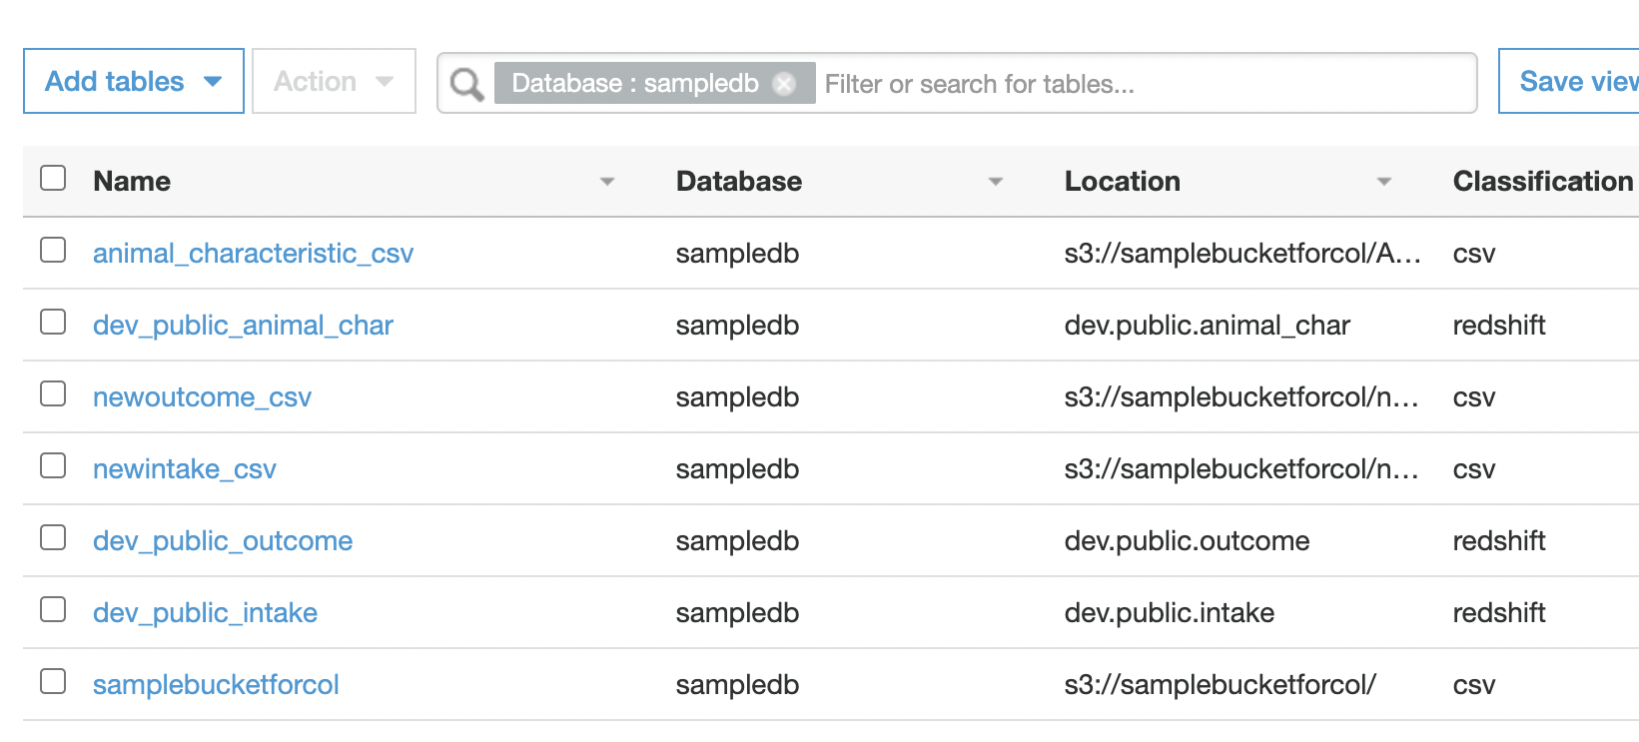
Classifier
Crawlers
IAM
Created Tables
AWS Glue Crawlers
Connects to S3, progresses through classifiers to determine the schema of data, and then creates metadata tables in data catalog

Slide 11
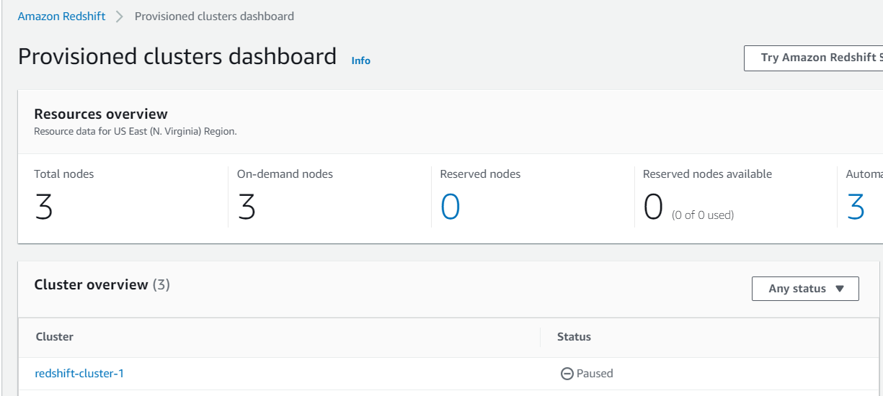
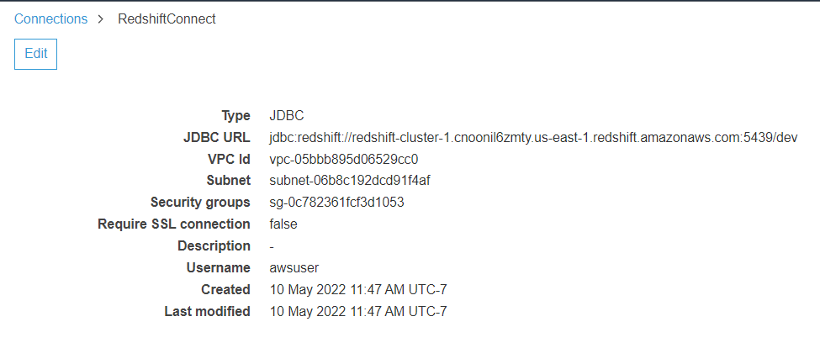
Redshift Cluster
JDBC Connection
AWS Redshift Connection

Slide 12
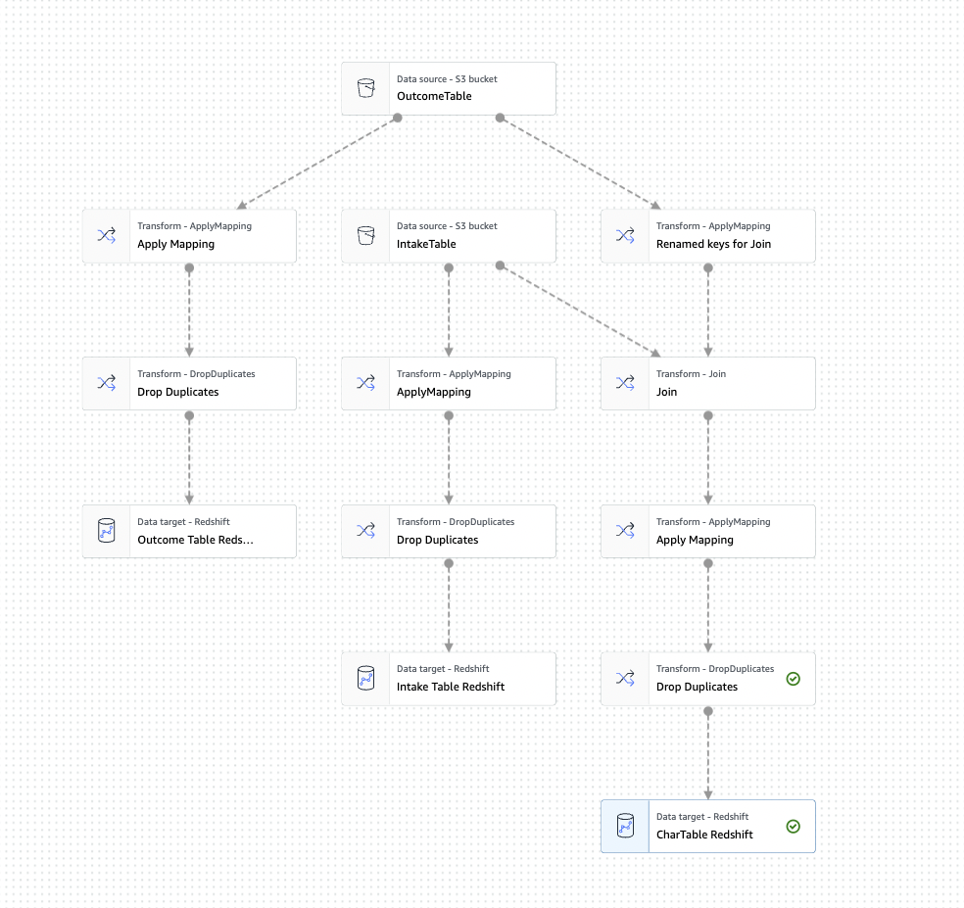
AWS GLUE Job
Transforming data from AWS S3 to AWS Redshift using AWS Glue’s ETL Job

Slide 13
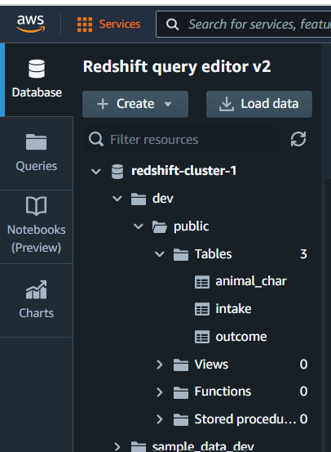
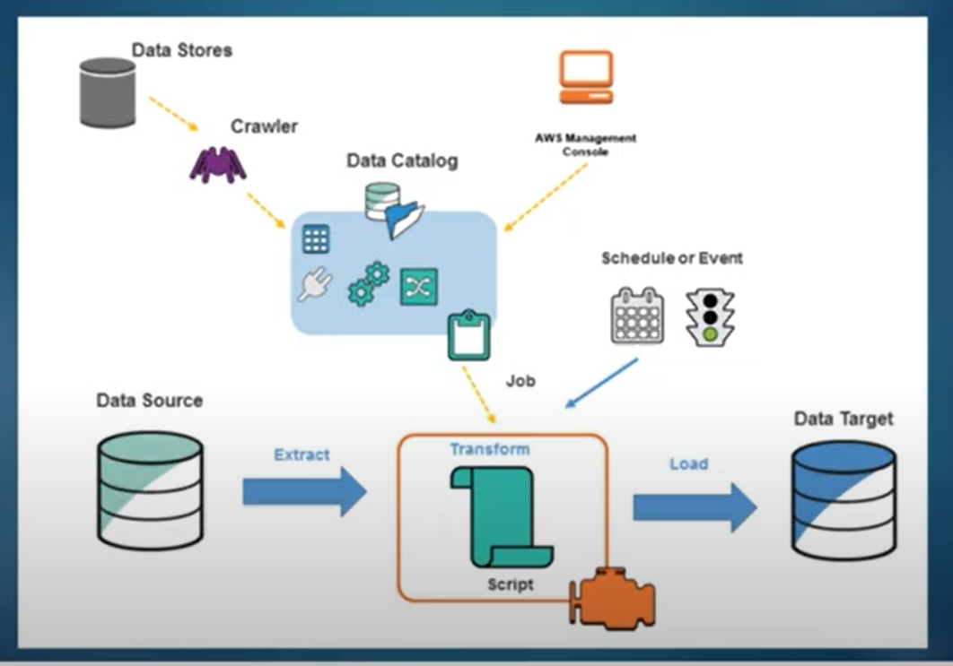
AWS Redshift
Data Target

Slide 14
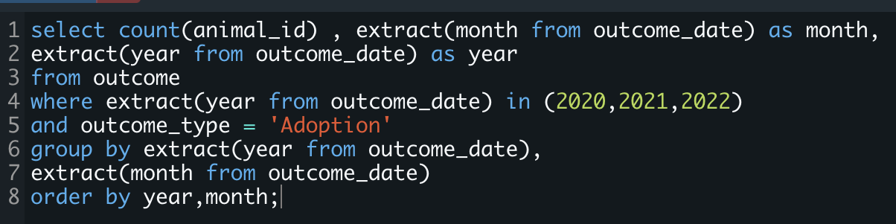
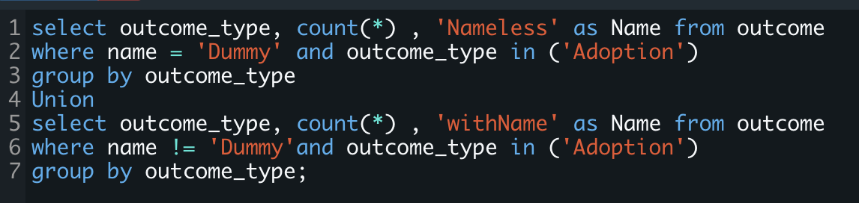
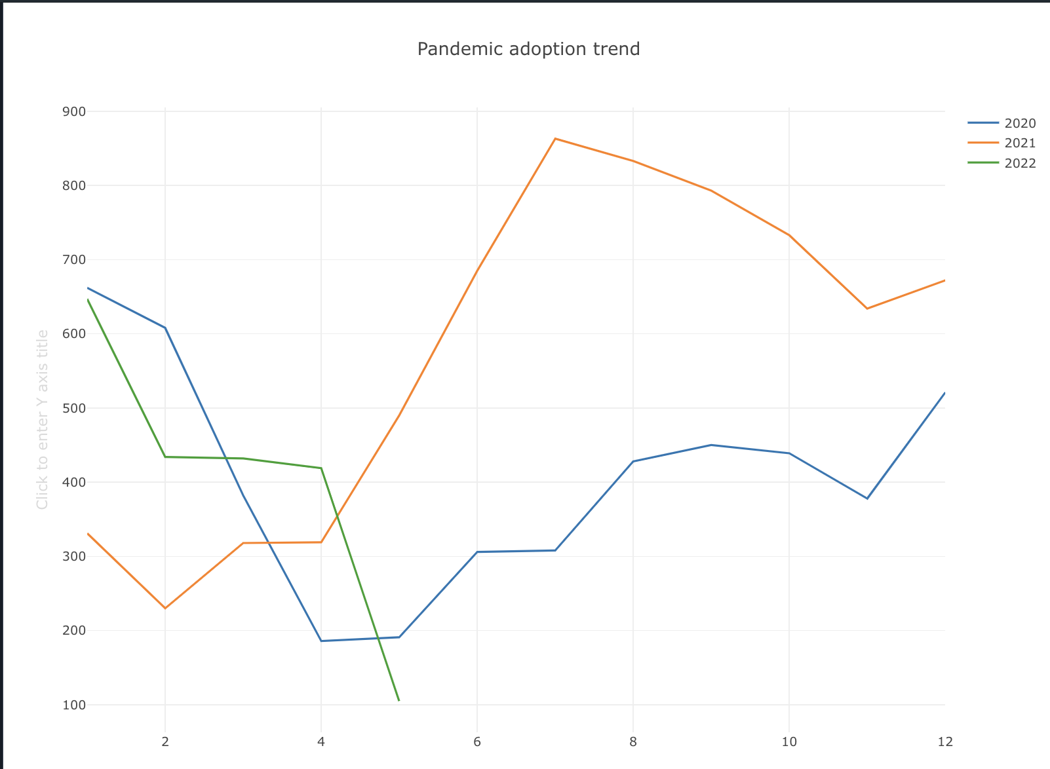
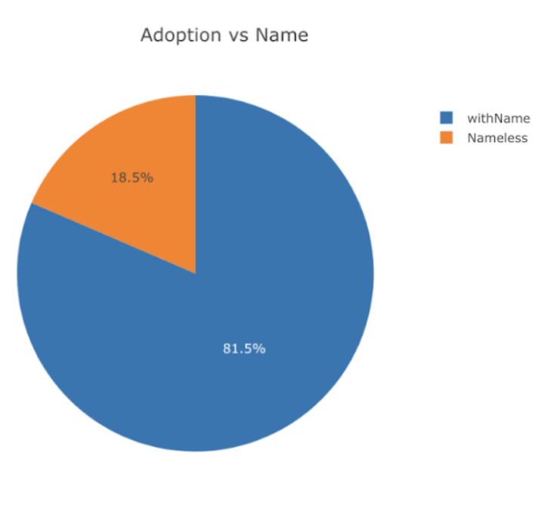
Analysis - Amazon Redshift
Adoption Trend during Pandemic
Adoption VS Name

Slide 15
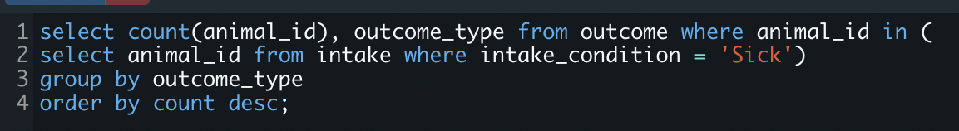
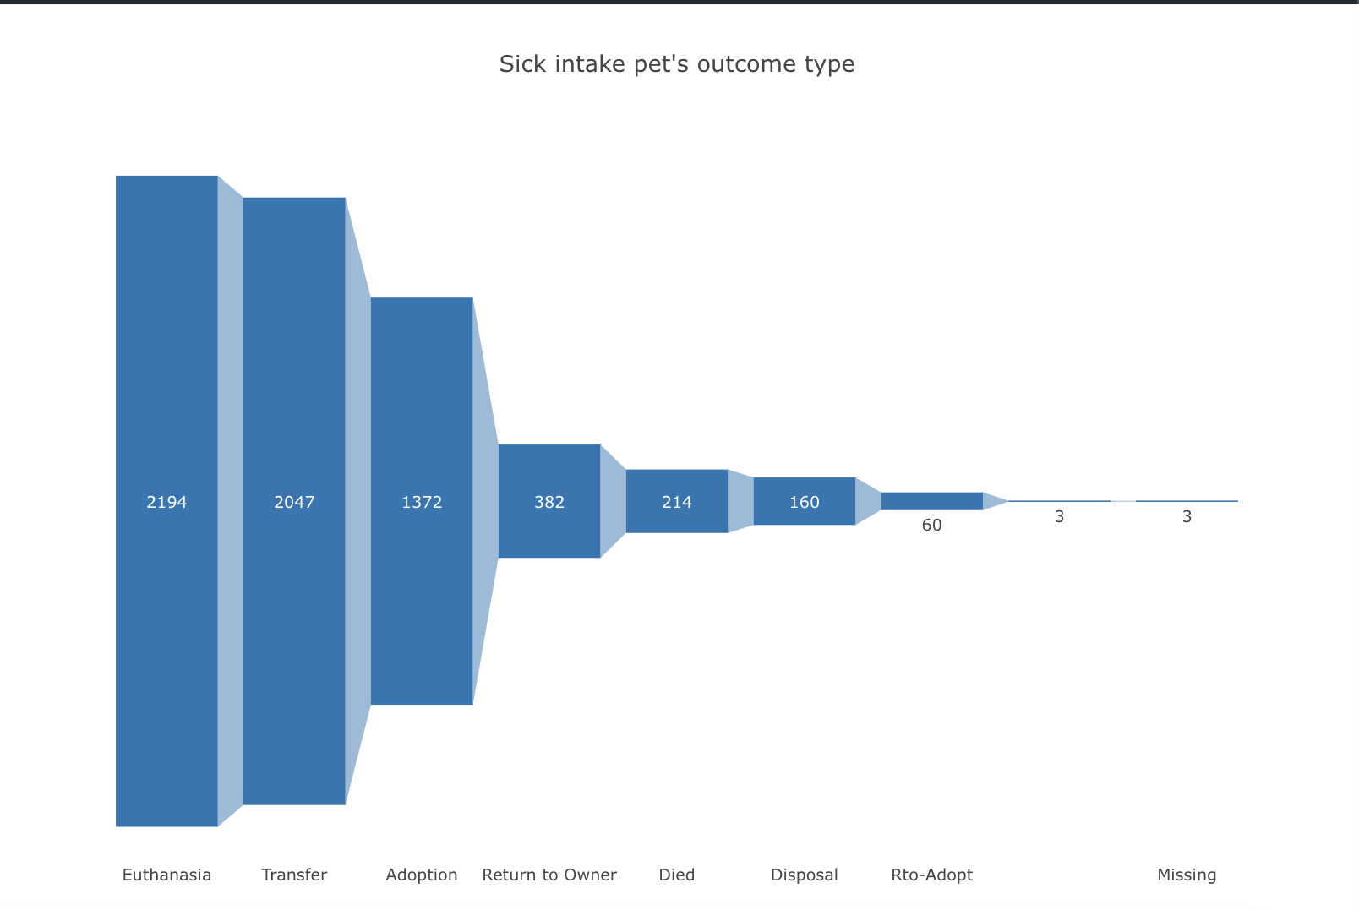
Analysis - Amazon Redshift
Sick intake pet’s outcome type

Slide 16
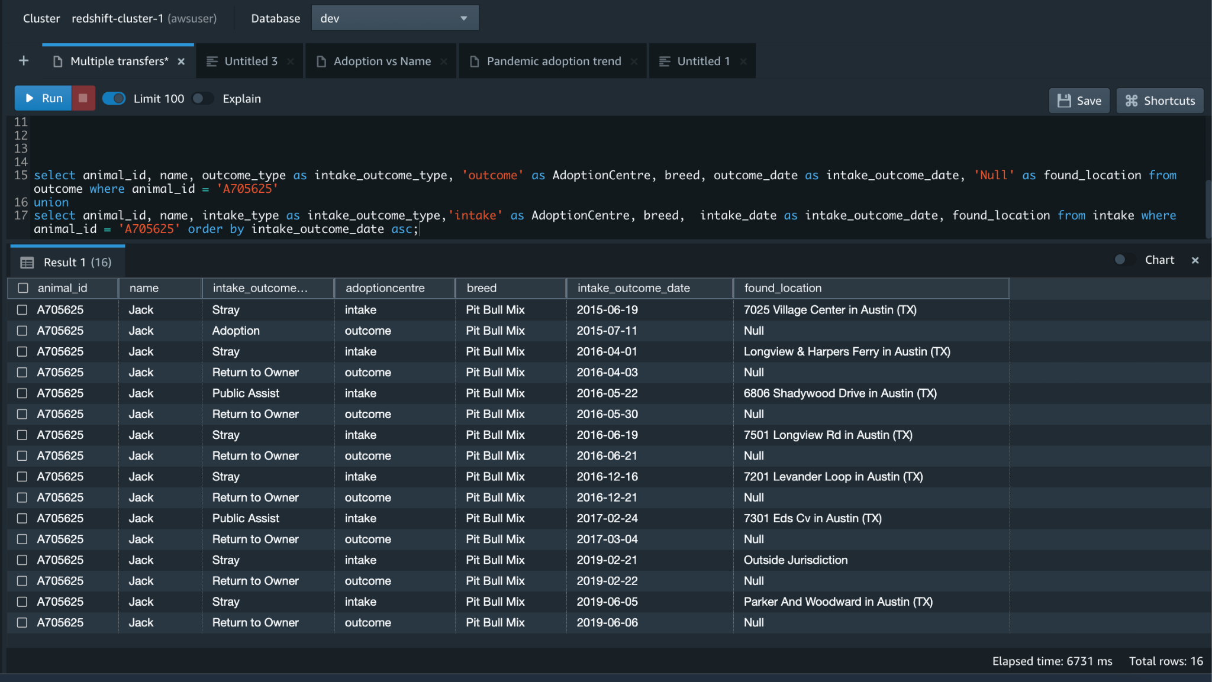
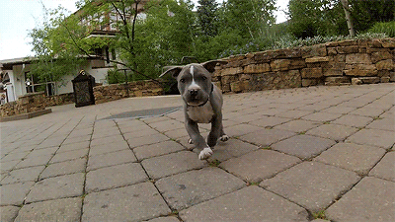
Analysis - Amazon Redshift

Slide 17
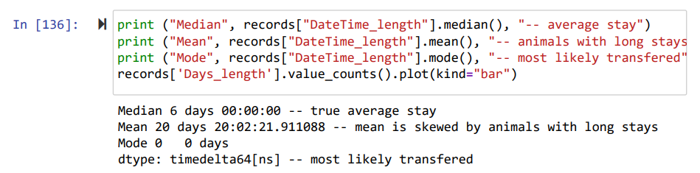
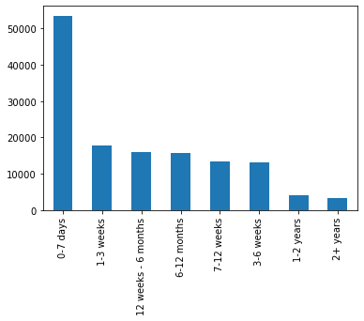
Analysis - Using Python
1)How long does the average animal spend in the shelter?

Slide 18
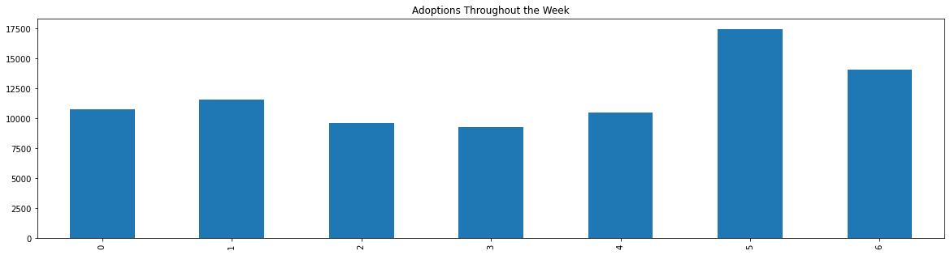
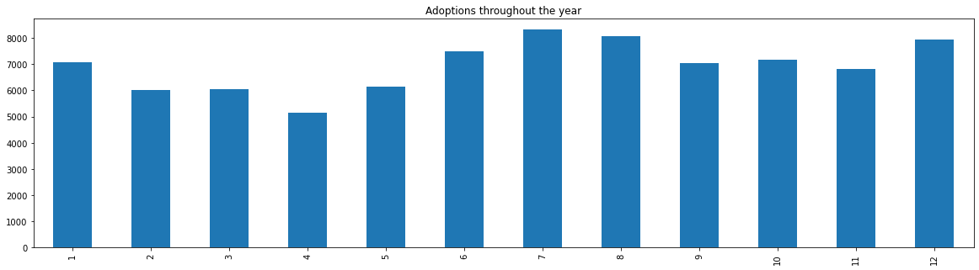
Analysis - Using Python
2)Are there certain months that people tend to make more adoptions on? What about certain days of the week (weekends)?
0 is Monday
1 is Jan

Slide 19
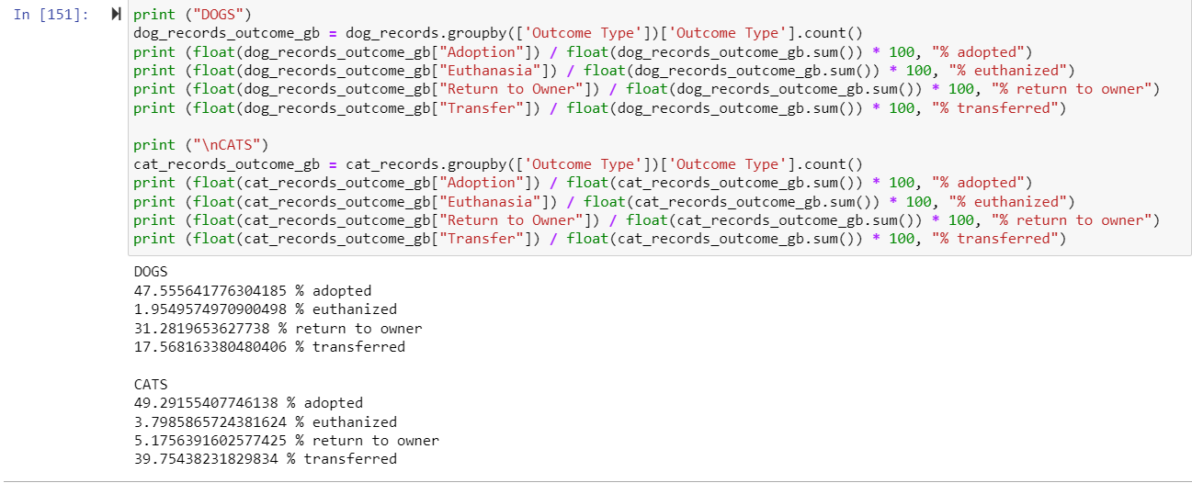
Analysis - Using Python
3)What is the likelihood of outcomes based on Dog vs Cat?

Slide 20
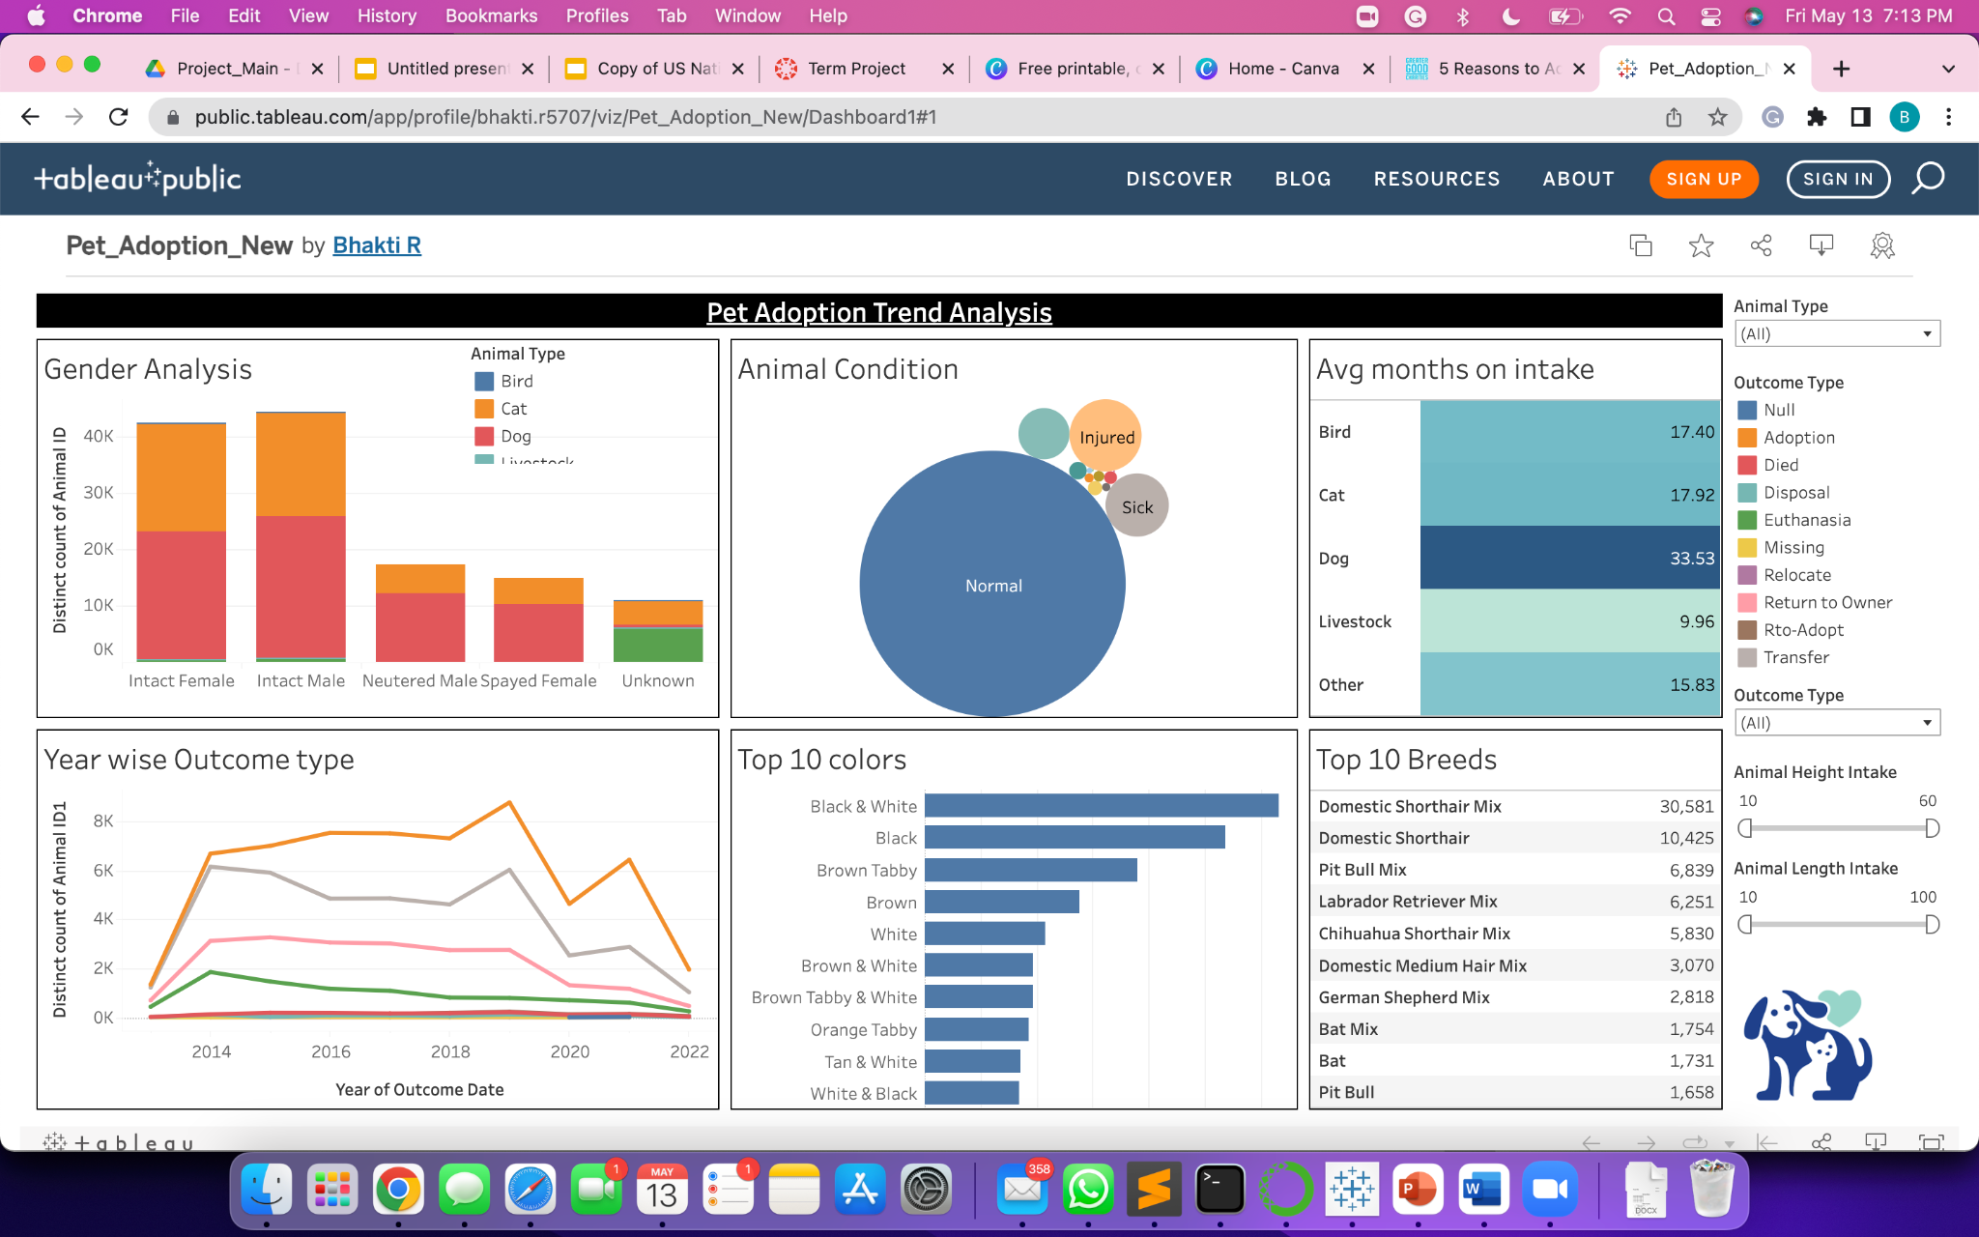
Data Visualization
Dashboard: https://public.tableau.com/app/profile/bhakti.r5707/viz/Pet_Adoption_New/Dashboard1#1
Website: https://bhaktiraichura1995.wixsite.com/pet-adoption-analysi

Slide 21
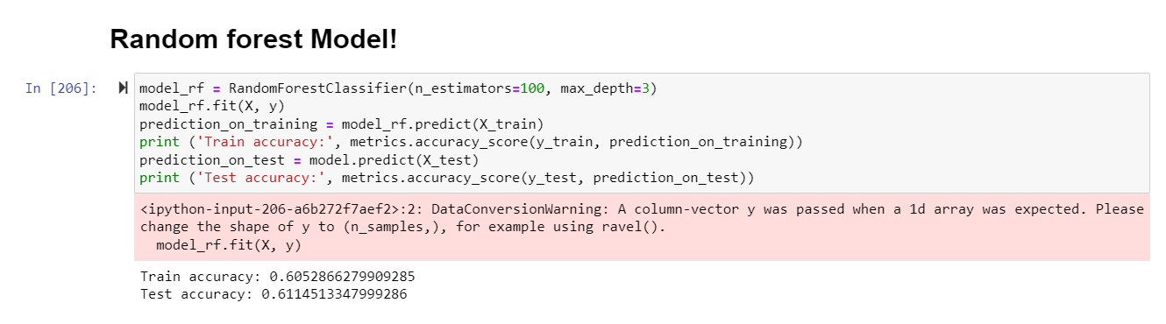
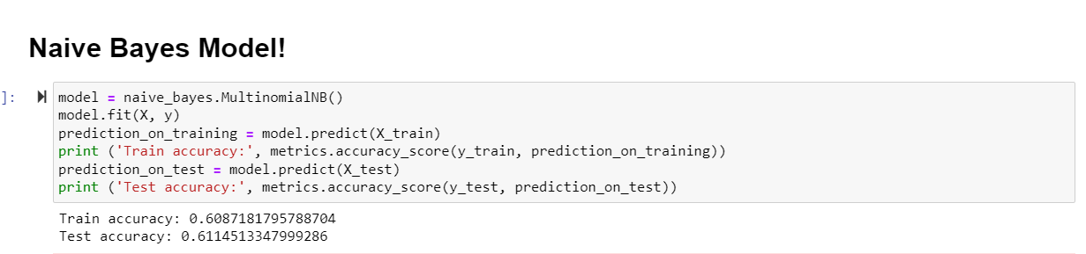
Prediction Models using ML

Slide 22
Models Comparison Table
Models | Training | Test
Decision Tree | 60.4% | 60.6%
KNN (Neighbors: 50) | 60.6% | 60.6%
Naive Bayes | 60.8% | 61.14%
Random Forest | 60.5% | 61.14%
Conclusion:- Using these results, the random forest and Naive Bayes models are the predictive model that works best for our predictive task of which animal will get adopted or not.

Slide 23
Exploring & Learning AWS Services
Collect Data from other cities
Dealing with categorical features
Try to find users data
Connecting AWS services to other platforms
Improve prediction accuracy
Analysis using various tools
Enhance on our website UI
Key Learning & Future Scope

Slide 24
References
Github
https://github.com/Dataanalystwhotellsstories/Data-228-Project
Website
https://bhaktiraichura1995.wixsite.com/pet-adoption-analysi
Dataset
https://data.austintexas.gov/Health-and-Community-Services/Austin-Animal-Center-Outcomes/9t4d-g238
https://data.austintexas.gov/Health-and-Community-Services/Austin-Animal-Center-Intakes/wter-evkm
Tableau Dashboard
https://public.tableau.com/app/profile/bhakti.r5707/viz/Pet_Adoption_New/Dashboard1#1
Literature Survey
https://www.aspca.org/helping-people-pets/shelter-intake-and-surrender/pet-statistics

Slide 25
Thank You
2 million
200 million
Any Questions?
Animals who die in shelters every year
Stray dogs in the world

